Slide 1

Empowering Minds
Salma Zhaid @ An Nisa Coaching
Notes:
1

Slide 2



Agenda
Who am I?
What do I want to become?
What are emotions?
Why is it important that we acknowledge and talk about emotions?
Tuesday, February 2, 20XX
Sample Footer Text
2

Slide 3




Introduction
This course will open your mind to acknowledge, that there is more to life than just, waking, doing and sleeping. There is a way of unlocking our unlimited potential, in this most abundant world. We have no clue, how long we’re here, so why not plan the future.
Tuesday, February 2, 20XX
Sample Footer Text
3
Notes:
3

Slide 4

Who Am I?
What are my roles?
What is expected of me?
Why me, why am I important?
Tuesday, February 2, 20XX
Sample Footer Text
4
Notes:
4

Slide 5
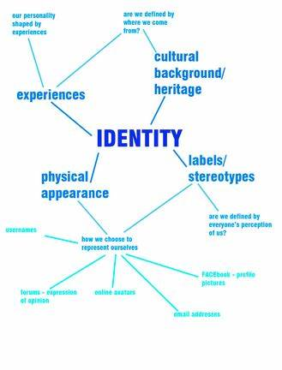
What we see?
Exercise
Make a Chart that defines you… have as many branches as you want:
Include: personal, values, ethnicity (if it matters)
Tuesday, February 2, 20XX
Sample Footer Text
5

Slide 6
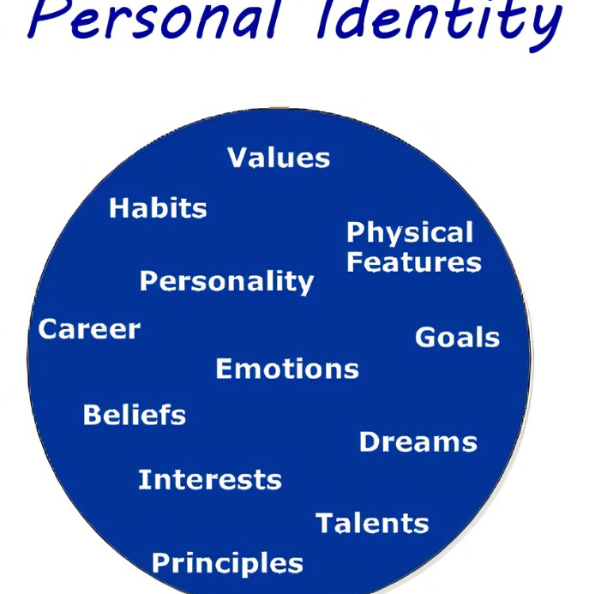
The way to get started is to quit talking and begin doing.
Walt Disney
Tuesday, February 2, 20XX
Sample Footer Text
6

Slide 7
Timeline
What would you like to achieve.
Are you asking the right questions?
Do the goals align with you and
What you want?
Have you considered beyond, what would you like to leave behind?
What will live on?
6 months
1 year
5 years
10 Years
20 years
Have you used the S.M.A.R.T method
(Discuss)
What steps are you taking to achieve this far ahead…
Tuesday, February 2, 20XX
Sample Footer Text
7
Notes:
7

Slide 8

Emotions
Some Guidance
Yes emotions are important
If not acknowledged, they can create a whirlwind around us
Don’t expect the emotions to just go away with time
You need to take action to know you’re in control of your emotions
Discuss negative emotions
What defines you as an emotional person
Release negative emotions as you identify them
Journaling and meditation can help
Do acquire therapy as and when required
Tuesday, February 2, 20XX
Sample Footer Text
8
Notes:
8

Slide 9
Know what you can Control.
Control
Influence
Can’t control
Yourself
Your actions and environments that you choose to attend
Look into controlling your emotions as and when you face them
How you show up, the way you dress, look after yourself and handle situations will make you feel good
Timing and Planning (whether you go ahead or not)
We have a slight influence over our students
Our children, showing them the right thing to do, practicing ideas and actions that you want them to adopt
Other people
Their thoughts and emotions
Weather
Some events in life/death
Tuesday, February 2, 20XX
An Nisa Coaching
9

Slide 10

Summary
Know what You Can control, You are the driver of the time that you have .
Believe in the best to achieve the best
Know where to create boundaries
Tuesday, February 2, 20XX
Sample Footer Text
10
Notes:
10

Slide 11


Thank You
Salma Zhaid
annisacoaching@yahoo.com
www.annisacoaching.com
Tuesday, February 2, 20XX
An Nisa Coaching
11

